Slide 1
School management system
Anton , Gisylia, André , Kevin

Slide 2
Communication and meetings
WhatsApp was used as our primary means of communication
Trello was used to view each task
Github was used to upload and share work between us
Library every Monday at 11am was our default meeting times
Class times was used as a milestone for the week

Slide 3
Task allocation
Using our strengths and weaknesses we decided to select task which we felt most comfortable with.
We also decided logically that we should choose the different tasks that we felt most comfortable with focusing working primarily on our strong areas
This was done by us all individually creating a concept map, mapping out our strengths and weaknesses

Slide 4
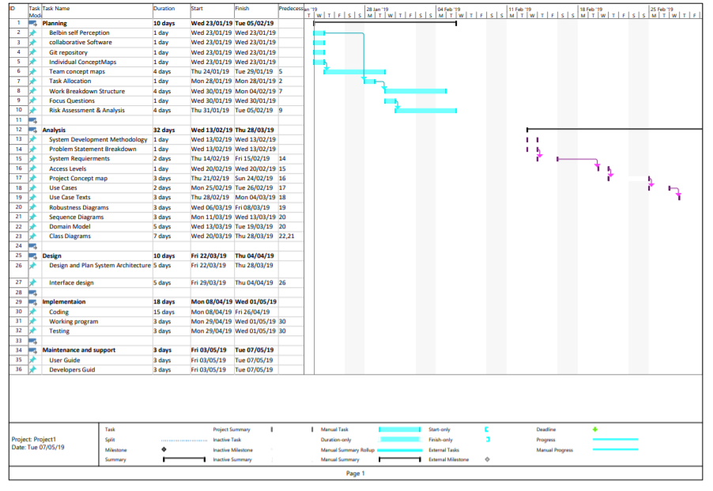
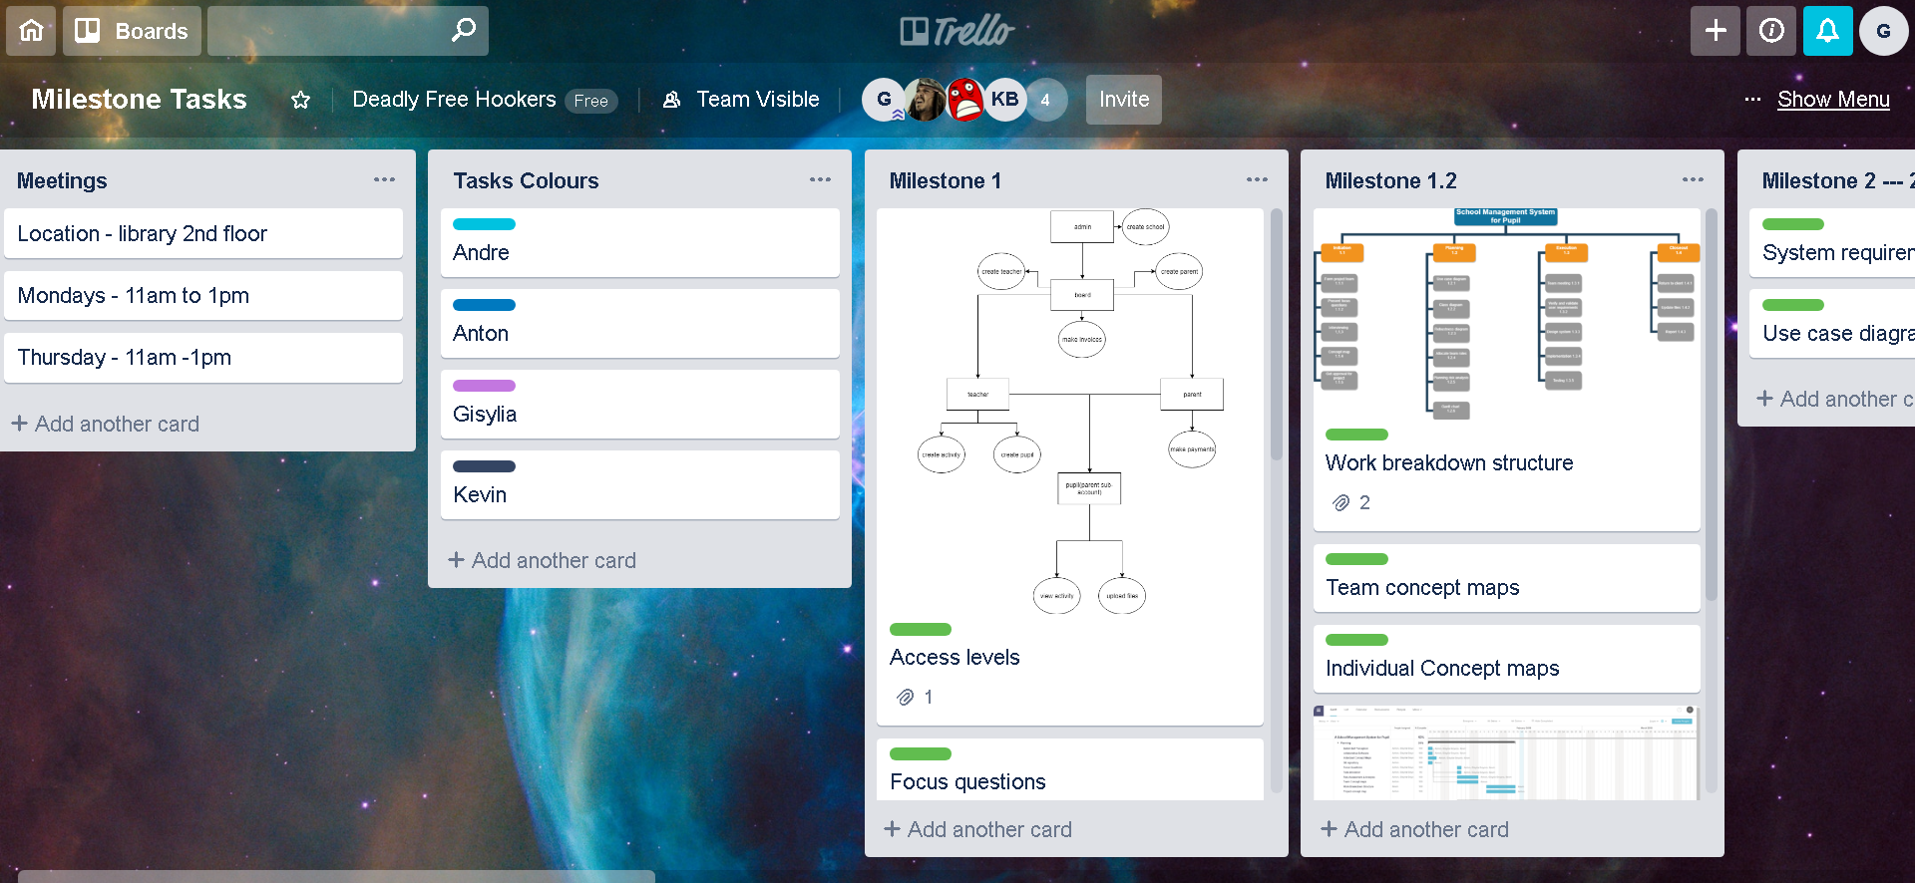
PLANNING
Tools

Slide 5
Beginning the project

Slide 6
School management system
Solent Day School is a local school for pupils from the ages of 1 to 10. The school is responsible for managing pupil’s daily activities during their stay in the school. These activities are then reported to the parents or guidance of every pupil. Other activities include the management of payments, image taking and uploads etc. The school has now grown in size tremendous and will need an efficient system to manage teacher-pupil-parent-school board daily activities.

Slide 7
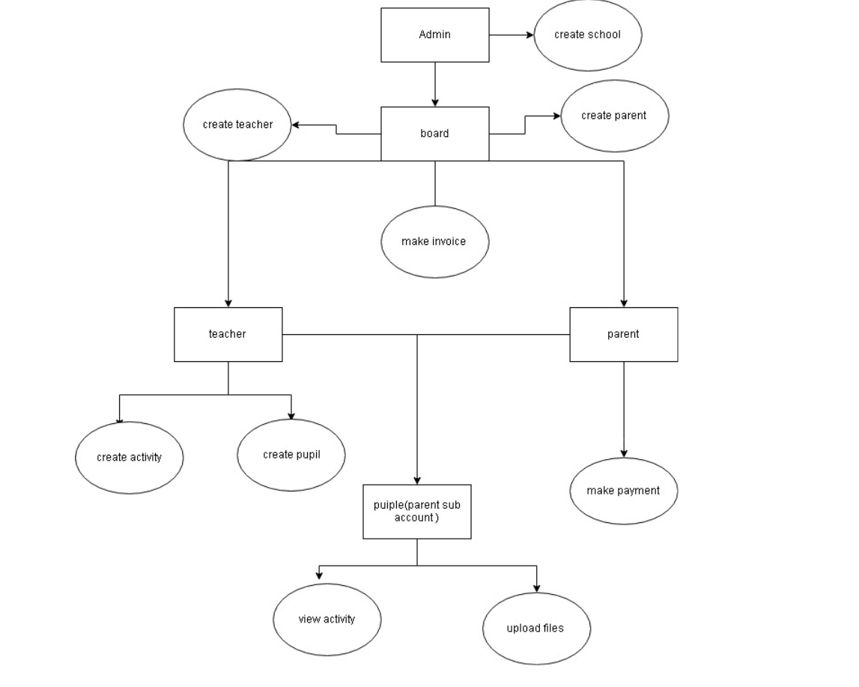
Access levels
After breaking down the case study and discussing it in our groups, we had created a access level diagram.
This was then used as the foundation of our project which all other diagrams would be based off

Slide 8
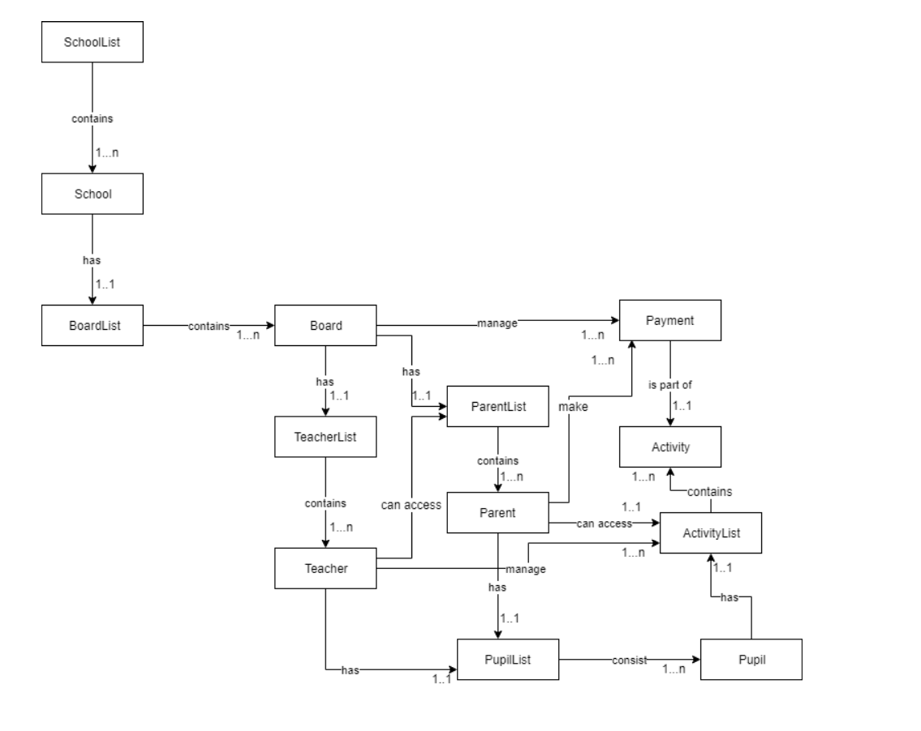
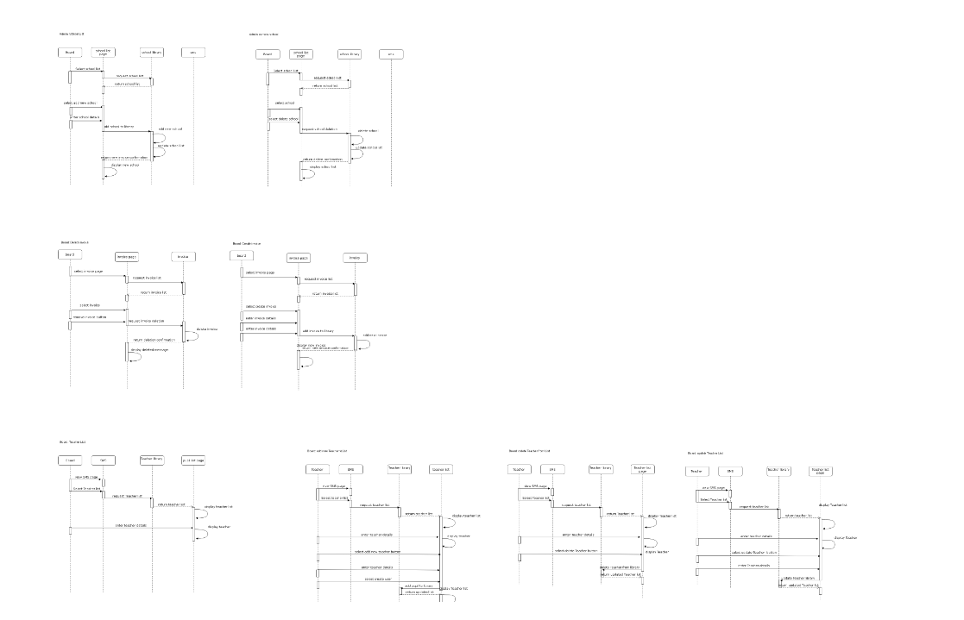
Diagrams

Slide 9
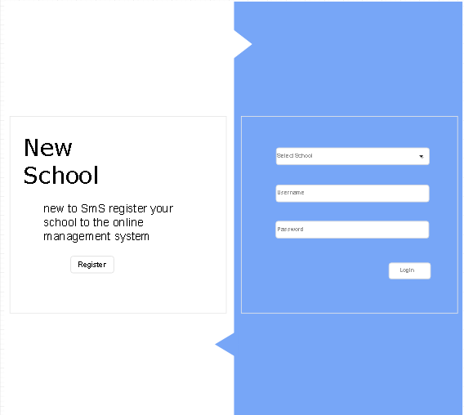
Design
Opting for a more simpler approach, we wanted to reduce the amount of clicking it would take for the user to complete each task.

Slide 10
Design
Simplicity: Eliminate unnecessary design elements and make your site easy to understand.
Hierarchy: Arrange your site so visitors naturally gravitate to the most important elements.
Navigability: Make your site’s navigation simple and obvious.
Consistency: The look and feel of your site should be uniform throughout.
Accessibility: Your site should be compatible with all devices (mobile, tablet, etc.).
Conventionality: Don’t reinvent the wheel. Use elements and design that people are familiar with.

Slide 11
Developing the system

Slide 12
Artefact demonstration

Slide 13
Thank you for listening
Anton , Gisylia Geyoro, Andre , Kevin

